Slide 1
Shell Bootcamp 2024 3 Reflections for Week 2
Rashi Agarwal
Date : 6-Sept-2024

Slide 2

About Me
“Do the best you can until you know better. Then when you know better, do better.”
- Maya Angelou
Please share an image / visual that best represents you

Slide 3

My learnings from this week! – Technical skills

Slide 4
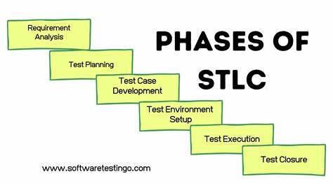
Learning 1 | My takeaways
Please share (in your own words) details of the learning.
SOFTWARE TESTING LIFE CYCLE
Requirement Analysis: Understanding and analyzing the testing requirements based on the client's needs and specifications.
Test Planning: Creating a detailed test plan, including the scope, objectives, resources, schedule, and risk management.
Test Execution: Running the tests as per the plan, logging defects, and retesting until the software meets the quality standards.

Slide 5
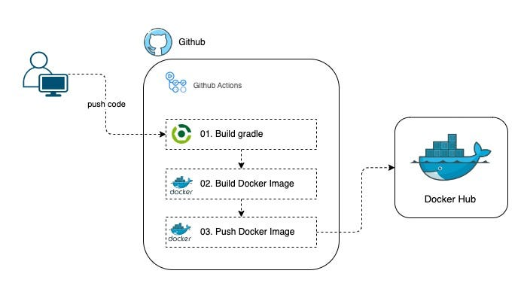
Learning 2 | My takeaways
Please share (in your own words) details of the learning.
GitHub Actions
Automation: GitHub Actions allows you to automate workflows directly from your GitHub repository. You can automate tasks like CI/CD, testing, and deployment.
Custom Workflows: You can create custom workflows using YAML syntax. These workflows can be triggered by various events such as pushes, pull requests, or scheduled times.
Integration: GitHub Actions integrates seamlessly with other GitHub features and third-party services, making it easy to build, test, and deploy your code.

Slide 6

Learning 3 | My takeaways
Please share (in your own words) details of the learning.
Cloud Infrastructure Components
Compute Resources: These include virtual machines (VMs), containers, and serverless functions that provide the processing power needed to run applications and services.
Storage Solutions: Cloud storage options such as object storage, block storage, and file storage allow for the scalable and secure storage of data.
Networking: This encompasses virtual networks, load balancers, and gateways that ensure secure and efficient communication between cloud resources and the internet.

Slide 7

Relevance of learnings for my organization

Slide 8
Learning 1 | Relevance for Shell
How I feel Shell implements this learning (in your own words)
Ensuring Reliability and Safety: STLC helps in identifying and mitigating defects early, ensuring that the software operates without failures, which is crucial for safety and reliability.
Compliance and Standards: STLC ensures that the software meets all regulatory requirements and industry standards, reducing the risk of non-compliance.
Optimizing Performance: Through rigorous testing phases in STLC, performance bottlenecks can be identified and resolved, leading to more efficient energy usage and cost savings.

Slide 9
Learning 2 | Relevance for Shell
Automation of DevOps Processes: Energy companies often rely on complex software systems for monitoring, control, and data analysis. GitHub Actions can automate the continuous integration and continuous deployment (CI/CD) pipelines, ensuring that updates and patches are deployed efficiently and reliably.
Improved Collaboration: With GitHub Actions, teams can collaborate more effectively on code development and testing. Automated workflows can handle code reviews, testing, and merging, which helps in maintaining high-quality code and reducing the time to market for new features and improvements.
Monitoring and Compliance: Energy sector software must comply with various regulatory standards. GitHub Actions can automate compliance checks and security scans, ensuring that the software adheres to industry regulations and standards. This helps in maintaining the integrity and security of critical energy infrastructure.

Slide 10
Learning 3 | Relevance for Shell
1. Scalability and Flexibility: Energy companies often deal with large volumes of data from various sources like smart meters, sensors, and IoT devices. Cloud infrastructure provides the scalability needed to handle this data efficiently, allowing for flexible storage and processing capabilities that can grow with the company's needs.
2. Data Analytics and Insights: Cloud platforms offer powerful tools for data analytics and machine learning. Energy companies can leverage these tools to analyze consumption patterns, predict maintenance needs, and optimize energy distribution, leading to more efficient operations and cost savings.
3. Disaster Recovery and Security: Cloud infrastructure provides robust disaster recovery solutions and enhanced security features. This ensures that critical energy systems and data are protected against cyber threats and can be quickly restored in case of any disruptions, maintaining the reliability and integrity of energy services.

Slide 11

Learning is also Fun!

Slide 12
Learning is also Fun!
We did many group activities in teams to which made us understand the concepts more and kept the classes interesting.
One of the group activity was to make paper air-planes which was a project that was given by our facilitator as to understand the importance of requirement analysis before starting working on any project. It was pretty fun and creative!

Slide 13
Thank You

